Slide 1
PDF Comparator Utility

Slide 2
Table of Contents
Introduction
Features
How to use PDF comparator Utility
Demo

Slide 3
Introduction
PDF comparator utility compares two pdf files, check their content, and give us the information that whether the both files have same content or not.
Utility is used to compare multiple pdf files in batch.
This utility is created on the top of tool “DiffPDF 2.1.3” using VBA.

Slide 4
Features
Batch file comparison
Page wise comparison
Word difference
Change in color of text
Change in background color
New/Change image in the source file
Font size and font type
Bold or normal text

Slide 5
PDF comparator Utility
This utility is easy to use. Before you use this utility, you have to copy files in Reference PDF and Target PDF folders.
Reference PDF folder:-
This folder contains the original PDF files, we can also refer it as a master PDF files.
Target PDF folder:-
This folder contains the PDF files with which we want to compare with the reference(master) PDF files.
Result Files folder:-
This folder will be used by the utility to store the generated files after the comparison.

Slide 6

PDF comparator Utility
In PDFComparison_InputFiles file , We need to enter file names in ReferenceFile and TargetFile columns.
ReferenceFile:- In this column we have to give the name of the PDF files with their extension. In this field give the name of the PDF file from the Reference folder.
TargetFile:- In this column we have to give the name of the PDF files with their extension, which we want to compare with the reference PDF. In this field give the name of the PDF file from the Target folder.
Result Files:- In this column, output will be generated after the use of the utility. If the PDFs are same, the output will be printed as “Files are same”. If the PDFs are not same, the output will be generated in below format.
Reference PDF file Name_Vs_Target PDF file Name.pdf

Slide 7
PDF comparator Utility
Double Click on the “PDFComparator.xla” file.
It will ask you for “Enable Macros”.
Click on “Enable Macros”.
Now click on “ADD-INS” from “Menu-Bar”.
Now click on PDF Comparator.
Now it will launch the utility.
Enter required details and click on Start Comparison.

Slide 8
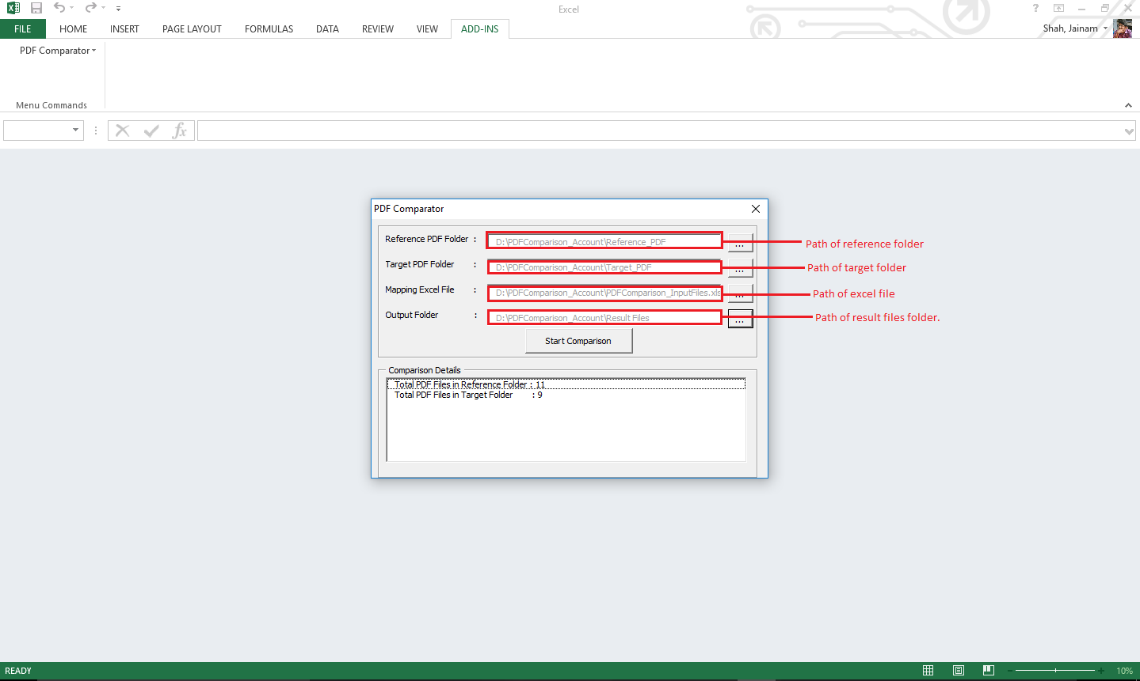
PDF comparator Utility

Slide 9
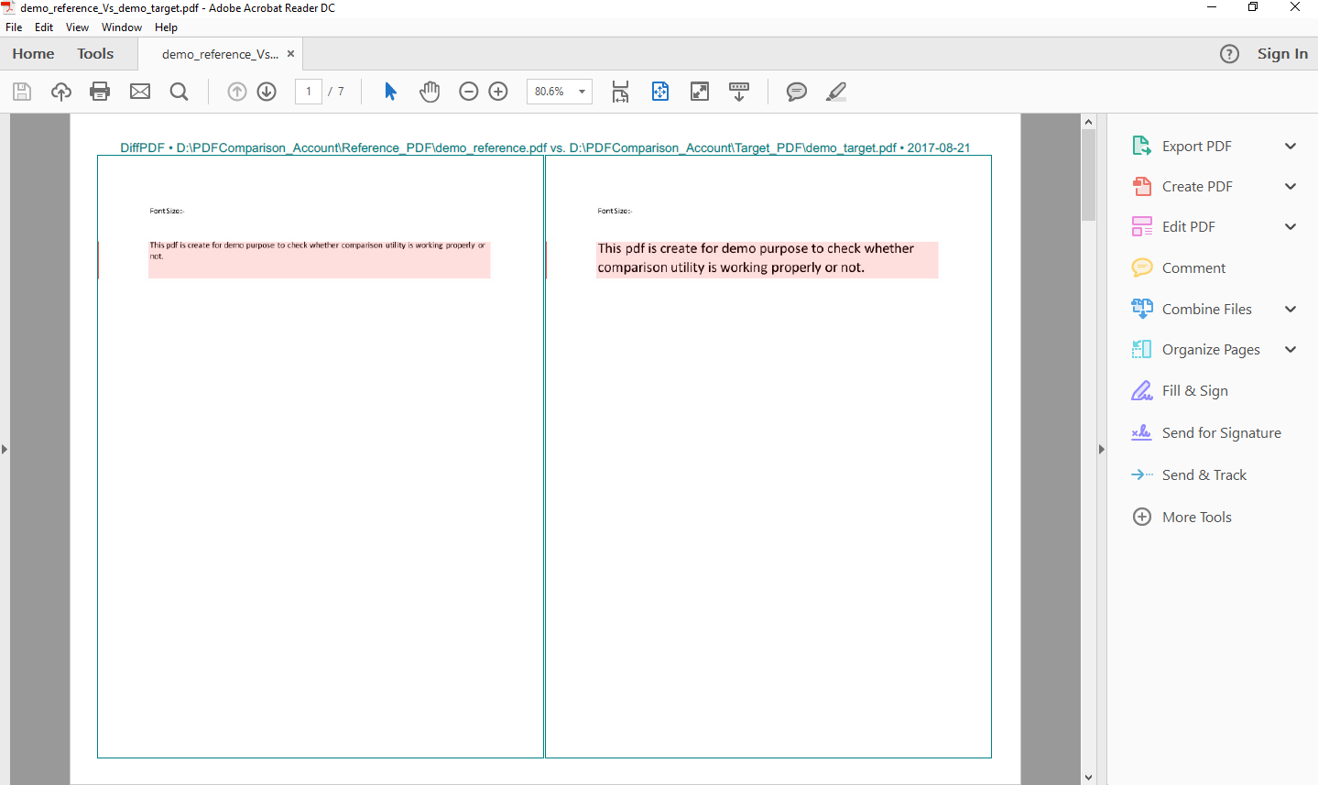
PDF comparator Utility

Slide 10
Demo
Demo

